Slide 1
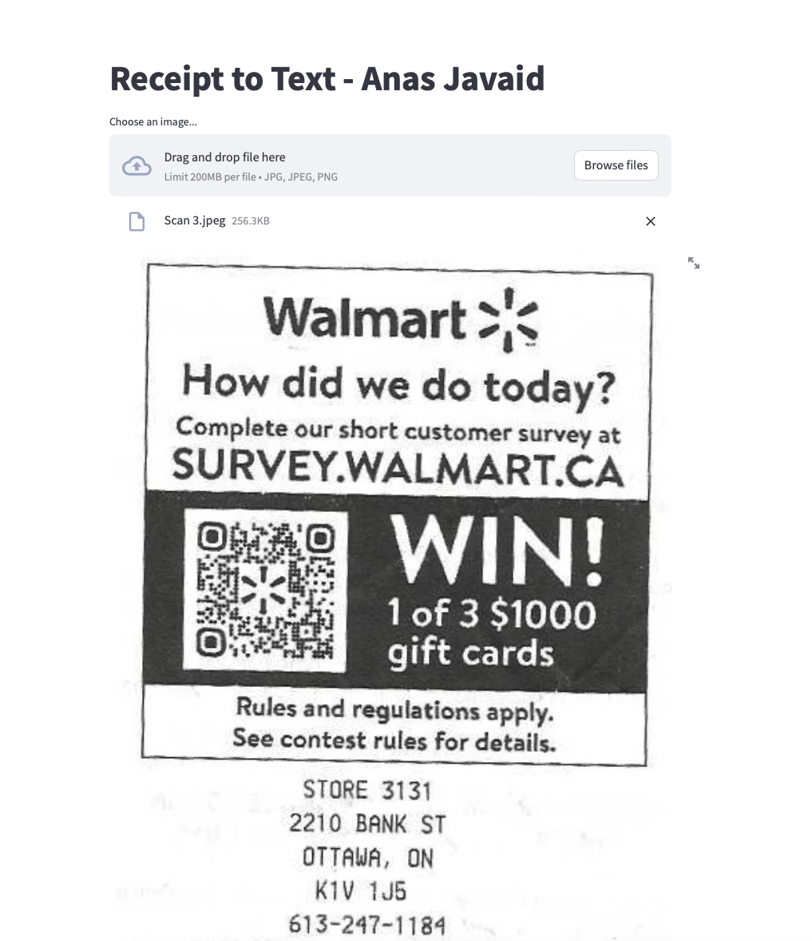
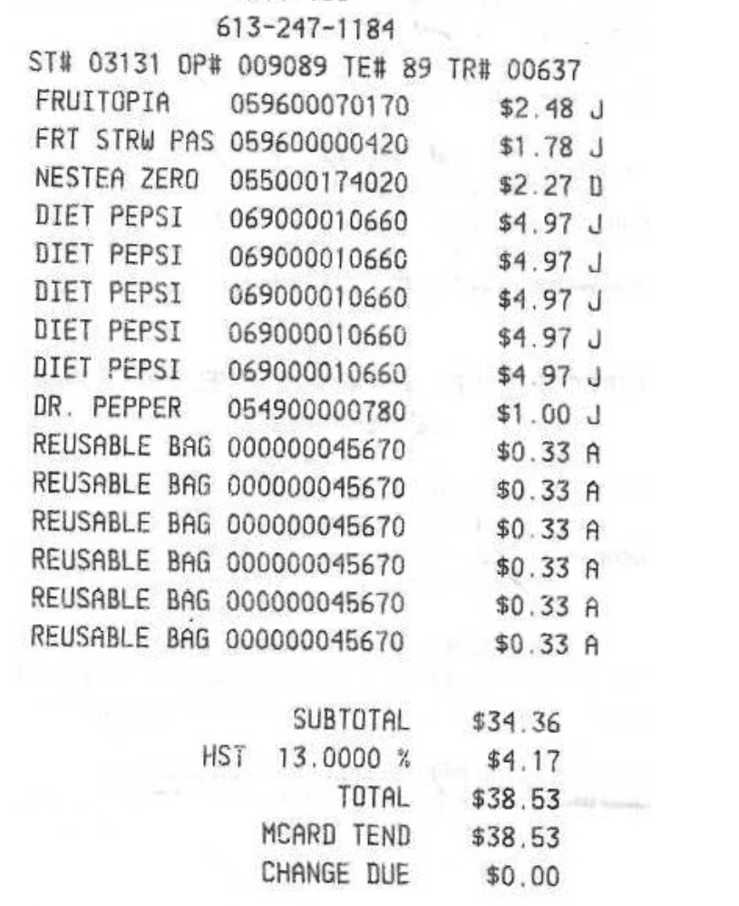
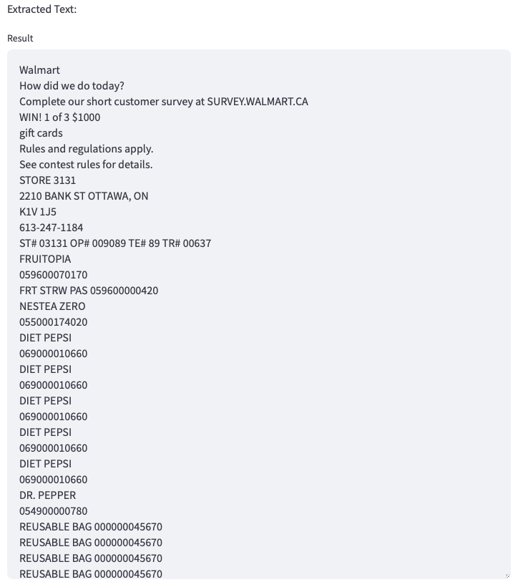
Receipt to Text (OCR) Project
Github Repo: /Anasj94/Receipt-to-Text-OCR
Main page - UI
Receipt
Results in Text

